Slide 1
Using Subqueries to Solve Queries

Slide 2



Slide 3
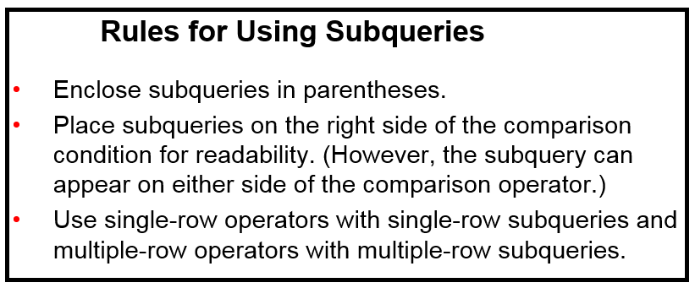

Slide 4



Slide 5
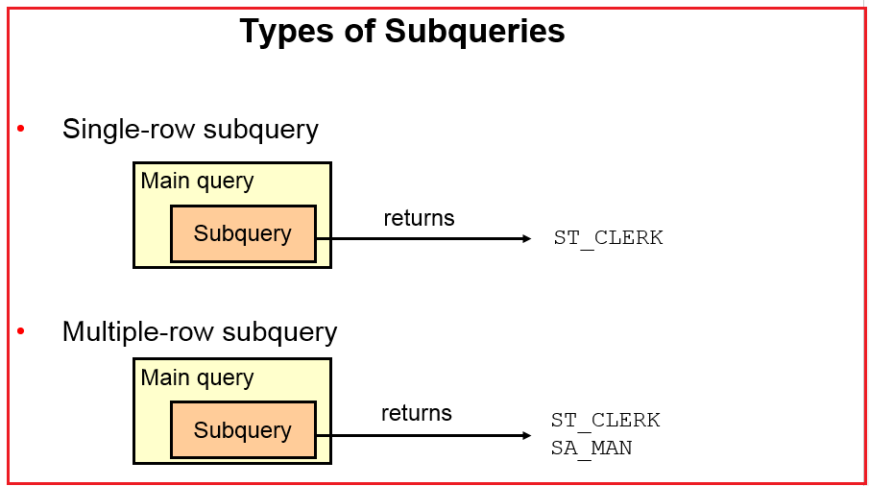
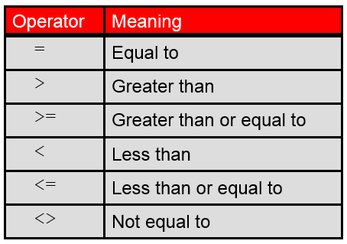


Slide 6
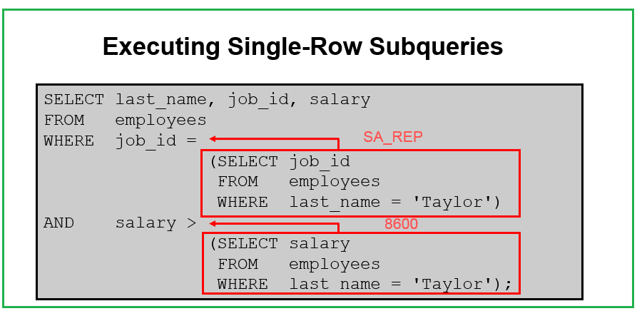

Slide 7
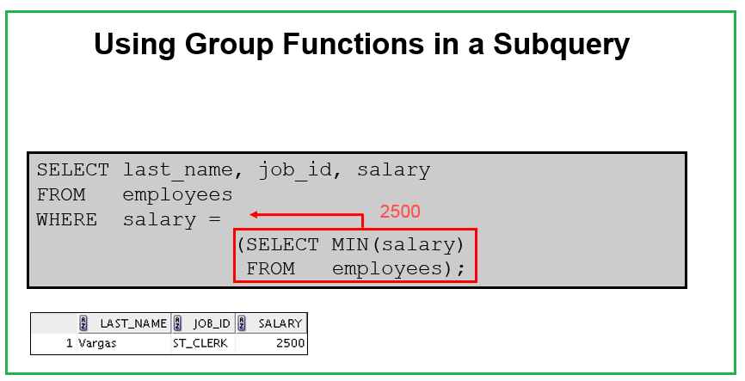

Slide 8
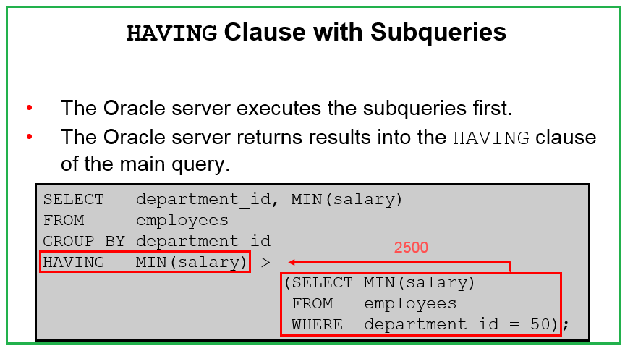

Slide 9
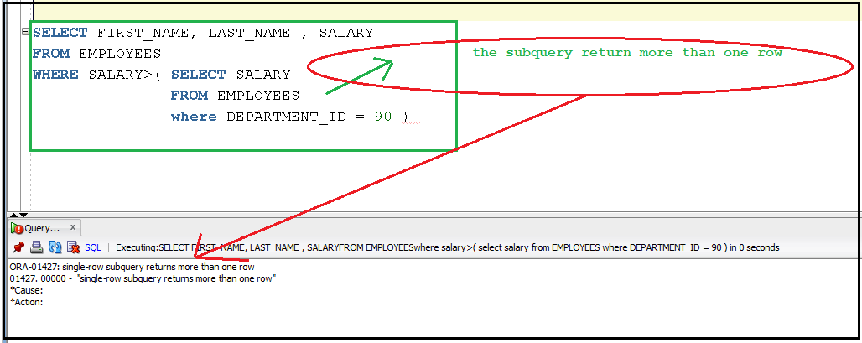
What Is Wrong with This Statement?

Slide 10
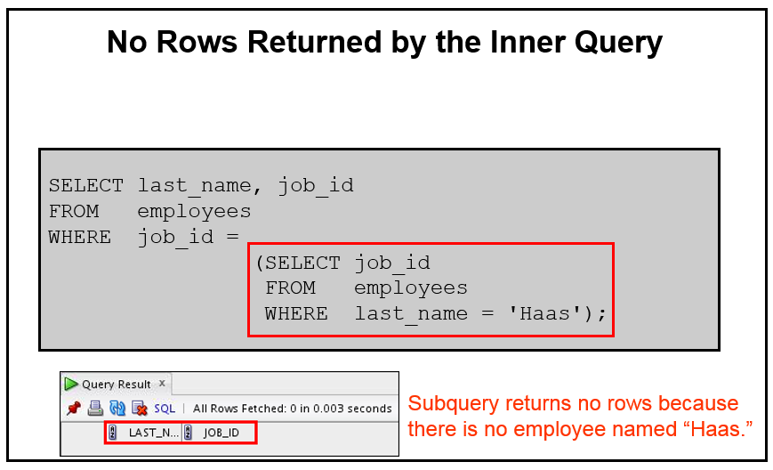

Slide 11
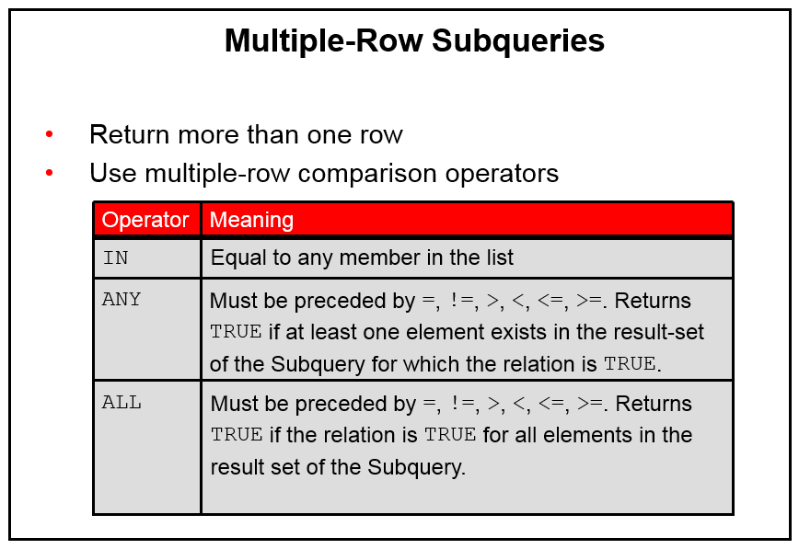

Slide 12

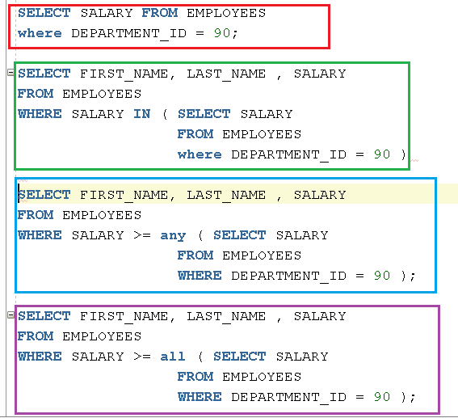



Slide 13



Slide 14



Slide 15

Do not use NOT IN when the subquery return some null values

Slide 16


Exists / not Exists
Note: always use table alias in exists/ not exists

Slide 17
Thank You
Prepared By :Khaled AlKhudari
15

